Slide 1




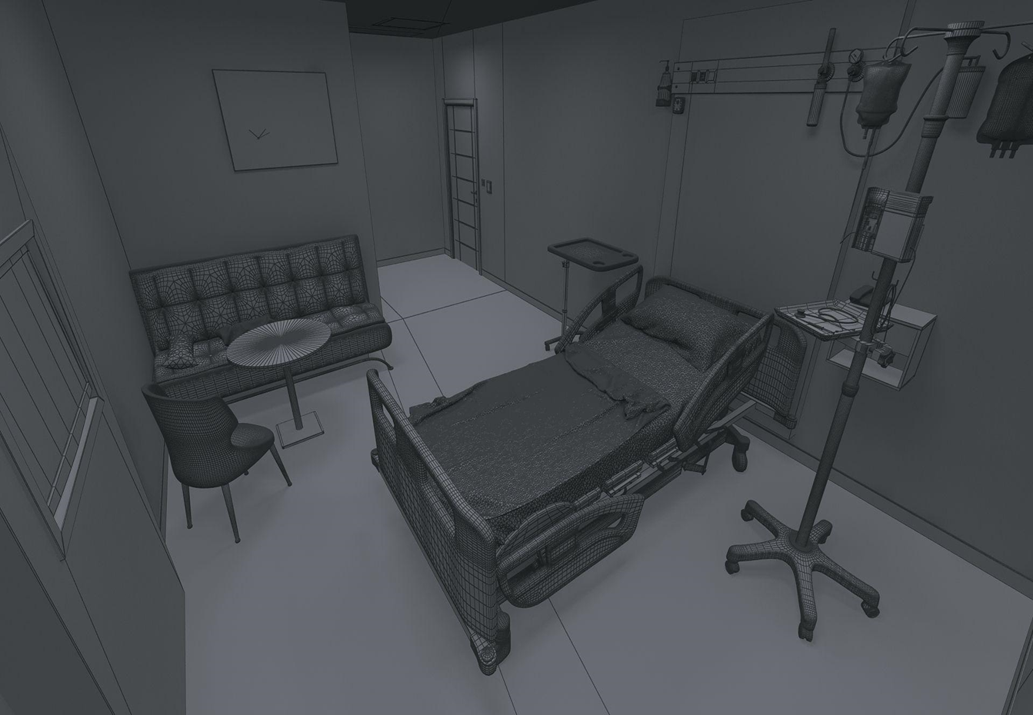
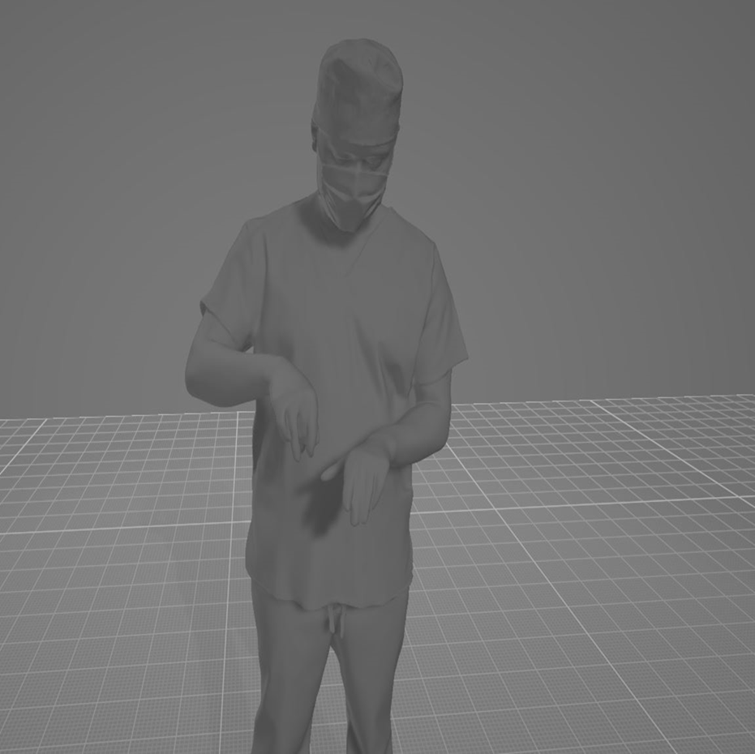









PhysioTrack
Group Number: W0223002 Students Names: Awab Mostafa, Ahmed Talaat , Arwa Eisa, Salsabil Mostafa, Farha Farghaly
Abstract
Results and data analysis
Conclusions
PhysioTrack is an intelligent, integrated system designed to improve the home rehabilitation experience for knee injury patients through accurate monitoring, interactivity, and motivation. Statistics show that nearly 50% of patients struggle with adhering to home exercise routines, and over 70% of knee injuries require consistent physiotherapy. Additionally, more than 60% of patients face psychological challenges such as anxiety or depression during recovery. The system uses IMU and pressure sensors to track movements in real time, with AI providing instant audio feedback for correction. Through virtual reality, patients engage with a virtual trainer in a gym-like environment. To boost motivation and mental well-being, users earn points to customize a virtual character, making therapy both effective and engaging.
around 50% of patients don’t complete home exercises, affecting their recovery.
Over 60% experience anxiety or depression during treatment, reducing commitment, And while 70% of knee injuries require regular therapy, many patients feel bored and stop.
The real issue: patients need more than exercises — they need support, motivation, and engagement.
PhysioTrack is a smart rehabilitation partner that enhances both the physical and psychological aspects of a patient’s recovery. By offering accurate movement tracking, real-time feedback, and motivational support, it helps patients perform exercises more effectively, speeding up recovery and reducing clinic visits. Additionally, the system boosts emotional well-being by offering encouragement and reducing feelings of isolation, fostering confidence and steady progress throughout the recovery journey.
Recommendation
1. Expand and regularly update the injury database (e.g., knee, shoulder, spine, ankle) to improve system accuracy and adaptability.
2. Collaborate with physical therapists to tailor the system to individual patient needs.
3. Partner with clinics and medical centers to integrate the system into ongoing therapy programs.
4. Add an instant support feature (e.g., chatbot or virtual assistant) to guide patients during exercises.
5. Continuously enhance the user interface and experience based on patient feedback.
6. Develop multiple device versions to accommodate various age groups and their unique needs.
7. Introduce a community feature to enable patient interaction, progress sharing, and peer support, boosting motivation and engagement.
Business Model Canvas
Introduction
Key Partners: 1. Physiotherapy Centers & Hospitals: Recommending PhysioTrack to patients, testing the device, and integrating it into treatment plans. 2. Sensors Technology Companies: Supplying advanced sensors like Accelerometer, Gyroscope, and Pressure Sensors to enhance movement tracking. 3. Cloud Service Providers: Providing a robust infrastructure for data storage and analysis using AI | Key Activities 1. Research and Development 2. Technology Development and Implementation 3. Manufacturing and Testing | Value Proposition 1. Smart, interactive rehabilitation using AI and VR technologies. 2. Real-time motion correction with sensors to prevent exercise errors. 3. Accurate performance tracking and detailed progress reports. 4. Safe, effective home-based therapy reduces the need for clinic visits. 5. Psychological support through motivational alerts and live voice feedback. 6. Remote monitoring and personalized guidance from doctors and therapists. 7. User-friendly design suitable for all age groups, including children and the elderly. | Customer Relationship 1.24/7 support for continuous assistance. 2. Progress tracking and motivational reminders. 3. Community for shared experiences and support. 4. Rewards to boost consistency and engagement. | Customer Segments PhysioTrack focuses on knee injuries, which are common in physical therapy due to sports injuries, osteoarthritis, or post-surgical recovery. The solution helps patients perform their exercises correctly at home. The primary target audience is patients with knee problems, while the secondary audience includes physical therapists, medical centers, and supportive family members involved in the recovery process.
 | Key Resources AI models for accurate movement analysis and correction, Sensors (IMU, pressure) for motion control, Safe zone detection for patient data analysis, APIs for device connectivity, VR environment with Unity and Oculus for therapy and motivation, Real-time voice guidance for correction, and Database of therapeutic exercises to enhance tools. |  | Channels PhysioTrack offers an integrated app and website for subscriptions, tracking, and doctor interaction. It will be available in physiotherapy centers, hospitals, and online stores like Amazon and Jumia. Awareness will be boosted through digital marketing and medical events to build trust with professionals.
Cost Structure Fixed Costs: App Development: 70,000 EGP , Sensors: 1,230 EGP/device , VR Development: 20,000 EGP , Cloud Setup: 10,000 EGP , Marketing: 4,000 EGP/month Legal & Licensing: 6,000 EGP Variable Costs: Manufacturing: 1,500 EGP/unit , Maintenance: 8,000 EGP/month , Cloud Storage: 2,000 EGP/month Total: Initial Costs: 111,230 EG, Monthly Costs: 11,500 EGP |  |  | Revenue Streams Subscriptions: Users pay 200–500 EGP/month for app features. Device Sales: The device is sold for 4,000 EGP. Medical Partnerships: Hospitals and centers purchase the device via contracts. Referrals: Users get discounts for referring new users. Payers: Individuals and medical centers Payment Methods:One-time device purchase or monthly/annual subscriptions.
Many patients struggle to follow their home physical therapy routines due to lack of follow-up, motivation, and psychological support, which can hinder recovery and increase the risk of injury. PhysioTrack addresses these issues by providing an interactive and engaging rehabilitation experience using virtual reality, artificial intelligence, and motion sensors. The system motivates patients through gamified exercises, real-time feedback, and emotional support.
This project supports the following Sustainable Development Goals (SDGs):
Goal 3: Good Health and Well-being
Goal 9: Industry, Innovation, and Infrastructure
Goal 10: Reduced Inequalities
References
1. العلو, د. س. س. (2024, May 20). the الصعوبات التي تواجه المريض لعدم الالتزام بجلساته العلاجية بمراكز العلاج الطبيعي. https://journals.zu.edu.ly/index.php/UZJWSES/article/view/177 2. فوضى العلاج الطبيعي في مصر: مراكز غير مرخصة ومخاطر صحية جسيمة. (n.d.). https://zawia3.com/physical-therapy-chaos/ 3. Harvard Health Publishing. (n.d.). Harvard Health. Harvard Medical School. https://www.health.harvard.edu/ 4. Tiga healthcare technologies. (n.d.). https://www.tigahealth.com/ar/elmuntecatu/mobithera-tatbikul-ilacil-fizyaiyyi-vel-medavatu-bil-ameli-an-buid/?utm_source=.com 5. PhysiApp® - المشاركة في الرعاية الصحية في متناول يدك. موثوق به منذ عام 2012. (n.d.). https://ar.physiapp.com/?utm_source=.com
Methods and Materials
1. Hardware Components:
MPU-6050 , FSR-402 , Raspberry Pi , Display Screen , Development Laptop or PC
2. Software Components:
AI Algorithms , Virtual Reality Environment , 3D Virtual Trainer , Reward Points System
3. Methodology:
Sensors are placed on the patient’s body.
The virtual physiotherapy environment is launched.
The screen shows both the trainer and the patient.
AI analyzes and compares patient movements in real-time.
Immediate voice feedback is given for incorrect movements.
Patients earn points based on performance, which they can use to customize their virtual avatar.
Acknowledgement
We would like to thank:
- Eng: Kyrollous Adel
- Ms: Aya Ali
- Eng: Fatma
- Eng: sandy
- nour taha
- our team

